Slide 1
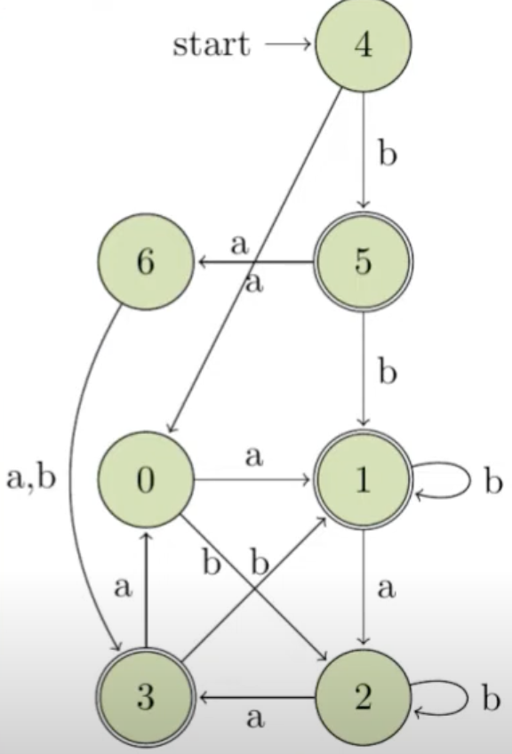
Myhill-Nerode Theorem for regular languages
Course Instructor: Dr. Sohail Iqbal
Book: Prof. Sipser-MIT
Slides: Prof. Busch - LSU

Slide 2
Introduction
Myhill–Nerode theorem provides a necessary and sufficient condition for a language to be regular.
The theorem is named for John Myhill and Anil Nerode, who proved it in 1957.
It also tells us the minimum number of states required in a DFA to recognize a language

Slide 3
Myhill-Nerode Theorem Says?
The theorem states that a language L is regular if and only if there are finitely many equivalence classes under the Myhill-Nerode relation
This equivalence relation tells us when two strings behave the same way with respect to the language L

Slide 4
Recap: Equivalence Relation
Def: Assume R is a relation on a set A, that is, R⊆AxA. We write aRb which means (a,b)∈R to indicate that a is related to b via the relation R:
R is reflexive if for every a∈A, aRa
R is symmetric if for every a and b in A, if aRb, then bRa
R is transitive if for every a, b, and c in A, if aRb and bRc, then aRc
R is an equivalence relation on A if R is reflexive, symmetric, and transitive
Examples: Equality and Birthday

Slide 5
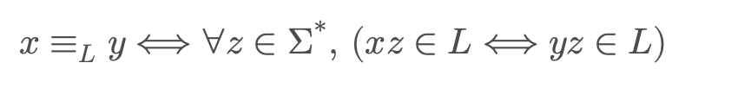
The Myhill-Nerode Relation
We define a relation ≡ₗ on strings as:
What this means:
Two strings x and y are equivalent if, for every possible string z, appending z to x and y gives the same result — both belong to L, or both don’t. In simpler terms:
x and y are equivalent if what comes after them doesn’t change whether they’re in the language or not.

Slide 6
Note
1. If there are finitely many equivalence classes under ≡ₗ, the language L is regular.
2. The number of equivalence classes corresponds to the minimum number of states in the DFA recognizing L.

Slide 7
L is not regular
Example 1: L = { a^n b^n | n ≥ 0 }
Take two strings: x = “a”, y = “aa”
Try appending z = “b”:
• x + z = “ab” (in L)
• y + z = “aab” (not in L) Since appending the same z leads to different results, these strings are not equivalent. In fact, there are infinitely many distinct classes (one for each count of a).
🔸 Conclusion: L is not regular!

Slide 8
L = a*b* (regular language)
Here, L contains any number of as followed by any number of bs.
The equivalence classes are:
• ε (empty string)
• a (some as but no bs yet)
• b (at least one b)
🔸 Conclusion: 3 equivalence classes → DFA with 3 states → L is regular!

Slide 9
Tip
How to Use the Theorem in Practice:
1. Partition strings into equivalence classes using ≡ₗ.
2. Count the number of distinct classes.
3.a) If finite classes → L is regular.
b) If infinite classes → L is not regular.

Slide 10
DFA States Minimization - MN Theorem
4
0
1
2
5
0
0
1
0
1
1
1
0
0
1
A
1
B
C
3
0
6
1
1
1
0
0
7
L₁={Λ}
L₃={1}
1
L₂={0}
L_{A}
L_{B}
L₅=Σ*{01}
L₄=Σ*{00}
L₇=Σ*{11}
L₆=L=Σ*{10}
L_{C}=L

Slide 11
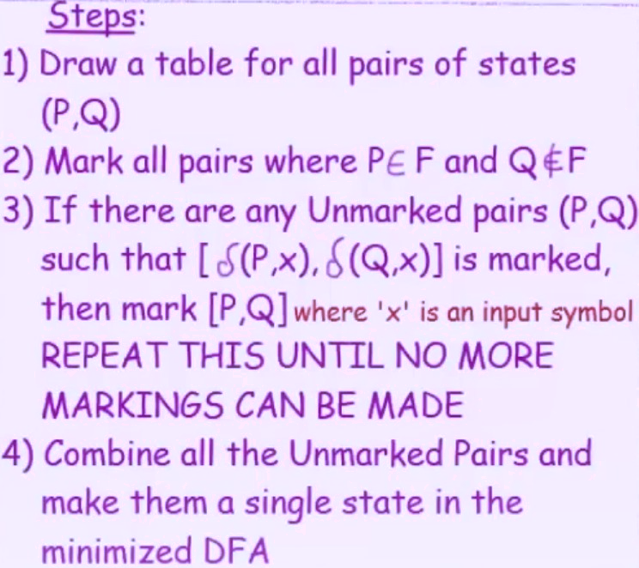
DFA States Minimization - MN Theorem
4
0
1
2
5
0
0
1
1
1
0
1
0
3
6
1
1
0
7
1
0
1
0
A
1
B
C
1
0

Slide 12
Detailed proof and Sate Minimization using Tabular Method in coming lecture!

Slide 13
Questions
Thank You!

Slide 14
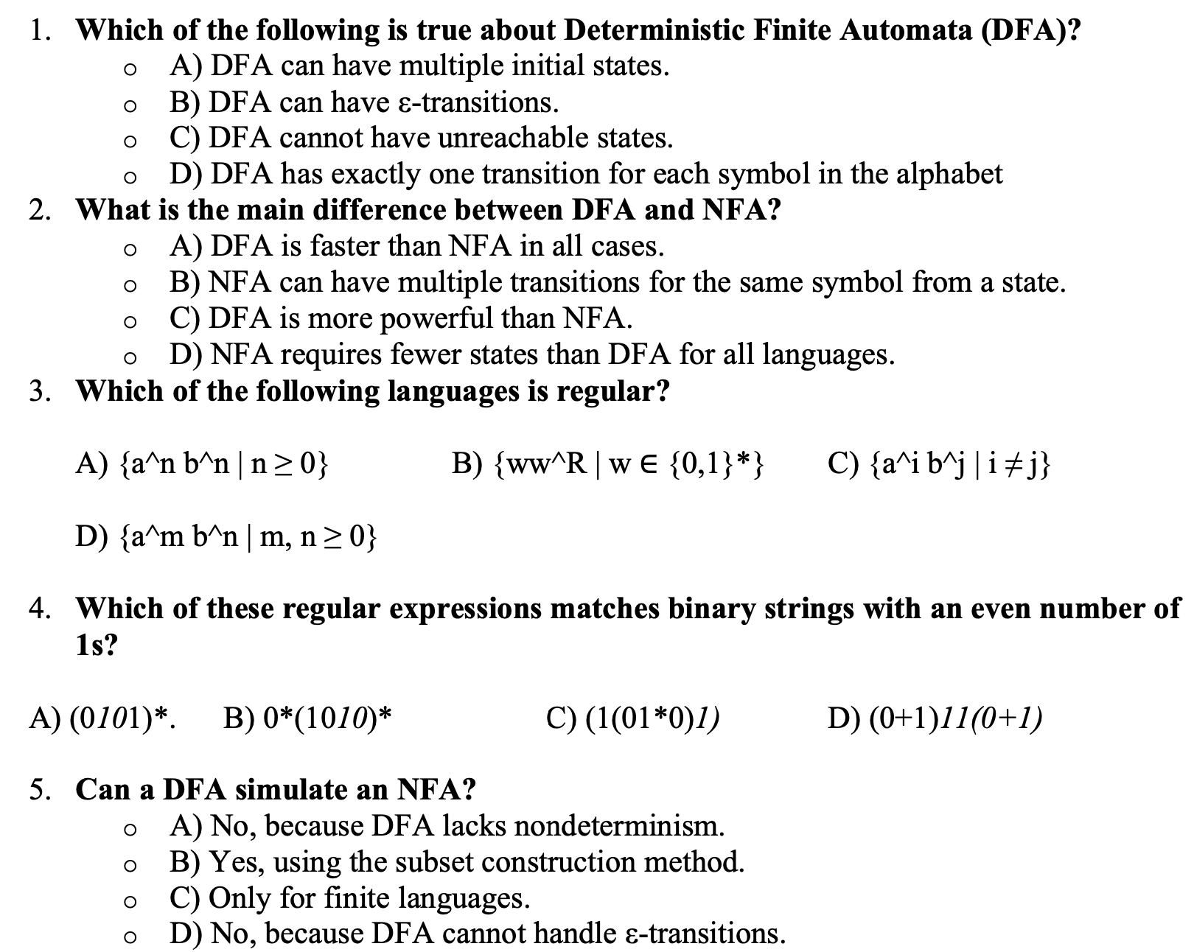



Feedback on Quiz 2

Slide 15
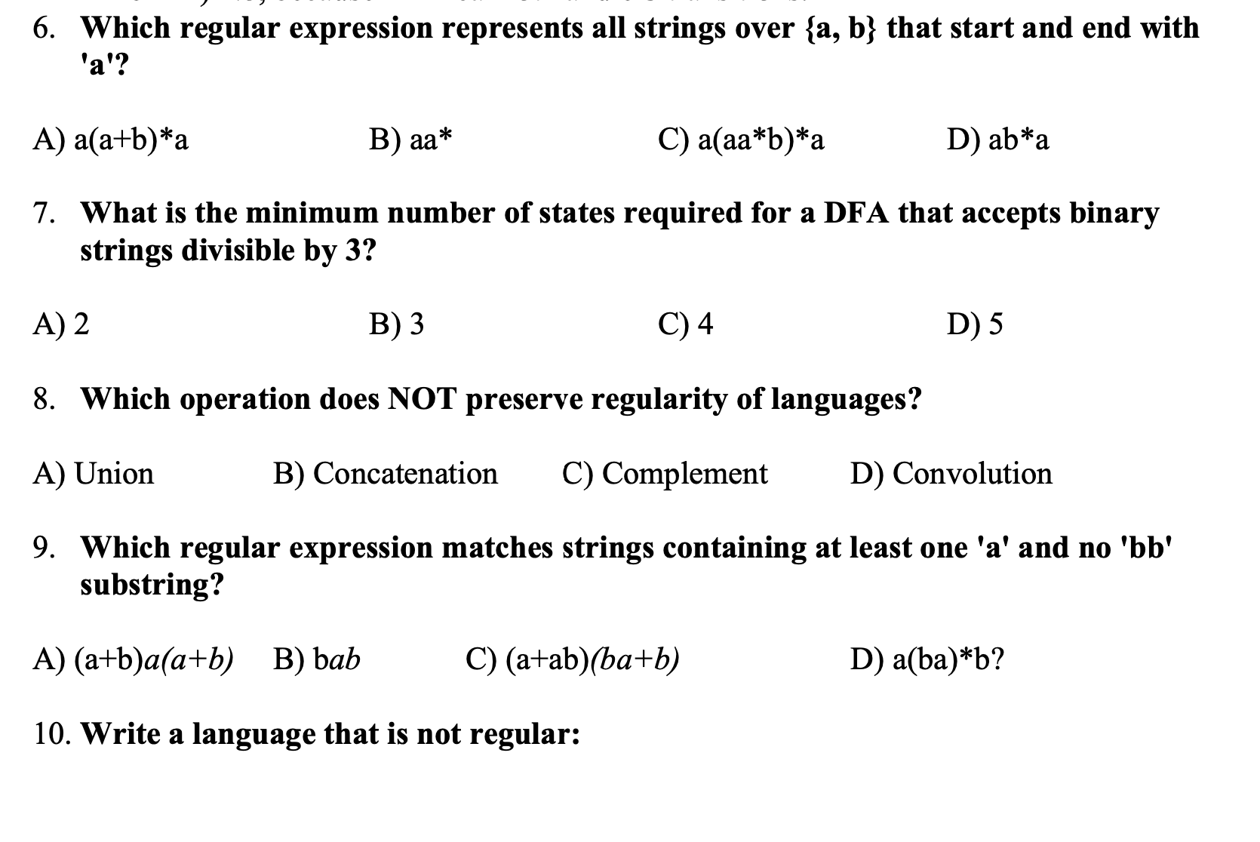



Feedback on Quiz 2
R={a^{n}b^{n} : n>=0}

